Slide 1

Opioid Abuse in TN
by Pandas Pandemonium
Vocals: George ‘Good Boy’ Toma
Guitar: Douglas ‘Big Boy’ Kaplan
Bass: Patrick ‘Long Boy’ Krystman
Drums/Jazz Flute: Abraham ‘Bad Boy’ Fongnaly

Slide 2
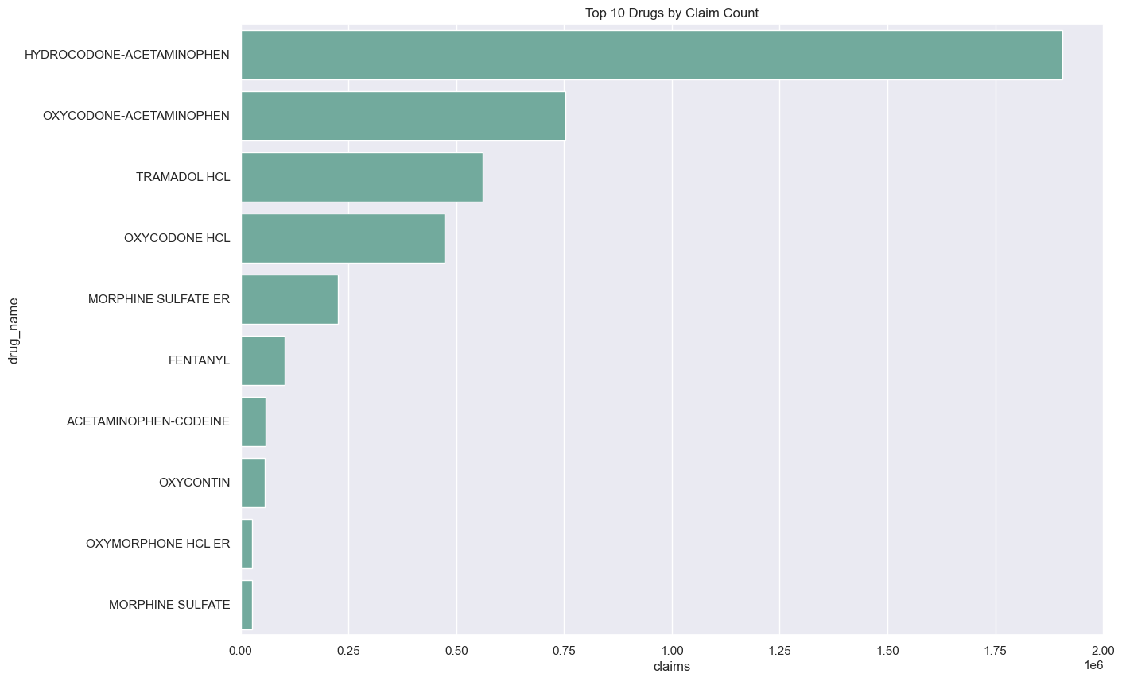
Top 10 Opioids Prescribed in TN

Slide 3
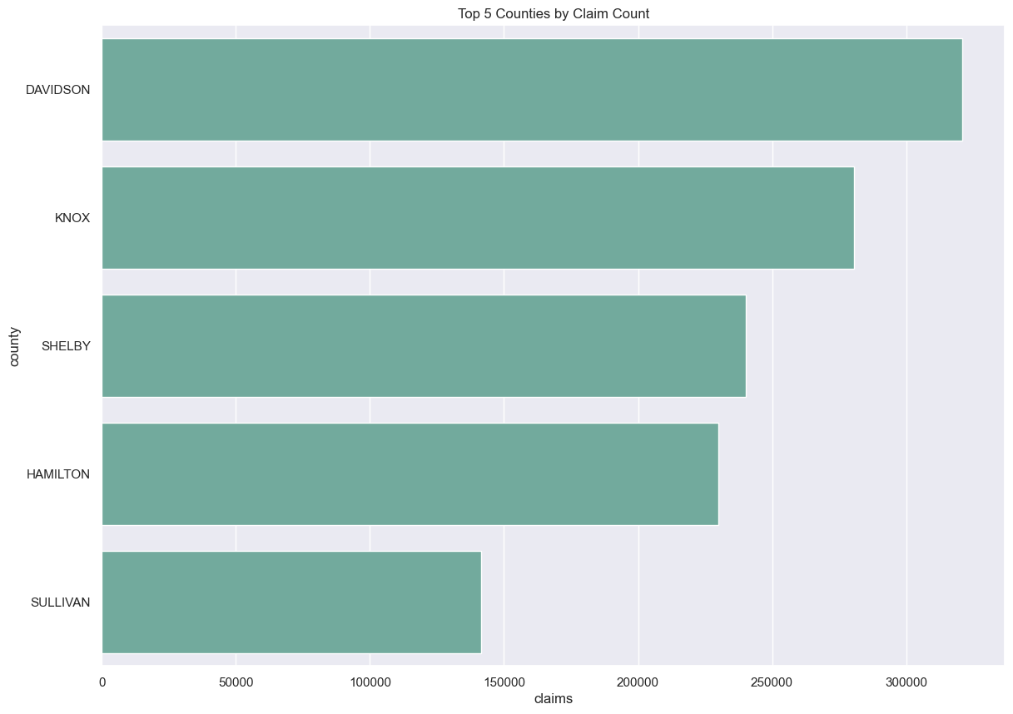
Top 5 TN Counties by Claim Count
Notes:
abraham

Slide 4
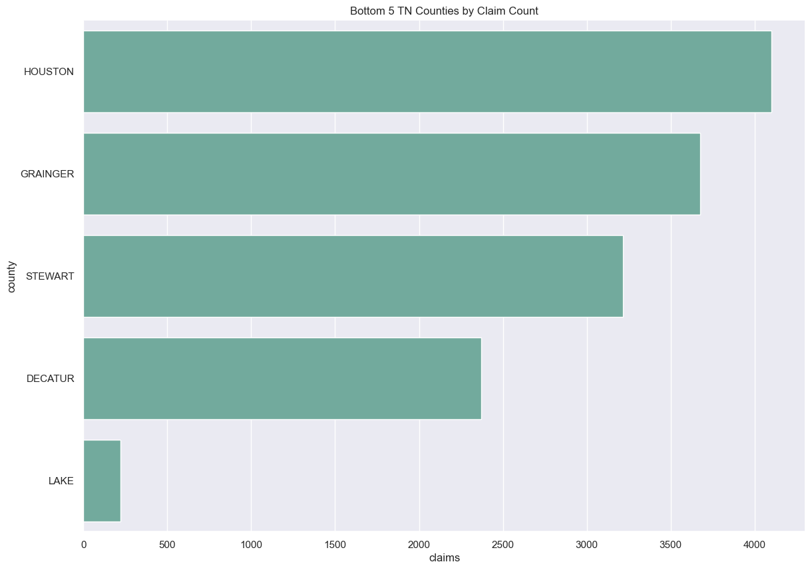
Bottom 5
TN Counties by Claim Count
Notes:
abraham

Slide 5
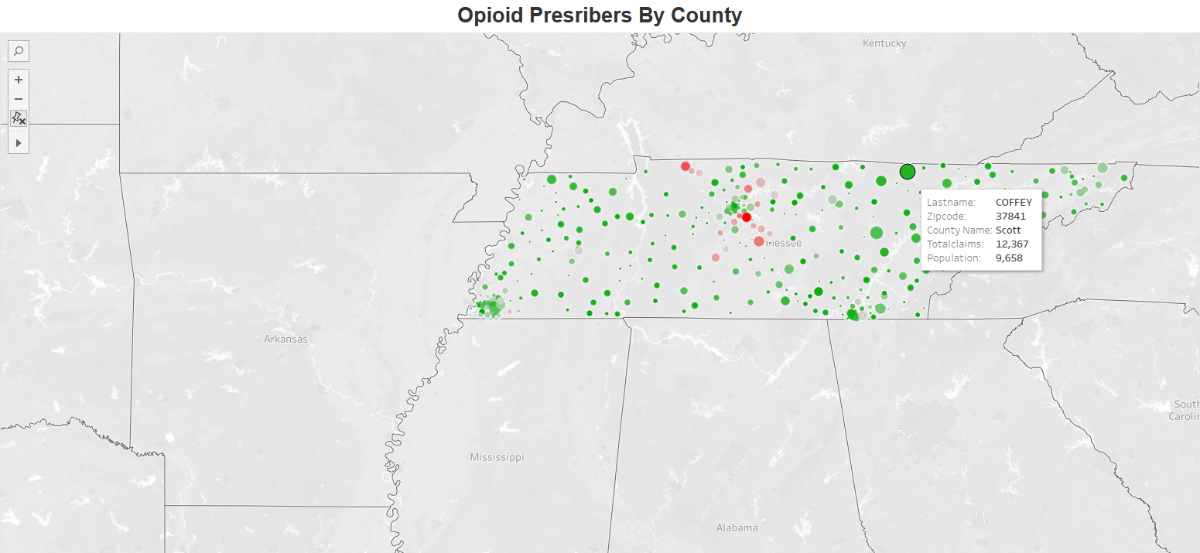

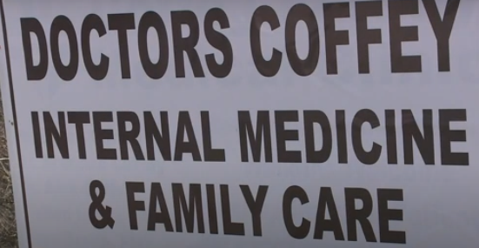
Top Prescribers
Key Findings: Based on population from the US census, the worst offenders based on total claims per population indicate that the metro areas are generally safer than outlying smaller towns as far as crooked doctors go. At his peak Dr. Coffey was prescribing 1,640 addictive pills per day across all patients according to the DEA (Source: Dr. Coffey reaches plea agreement in pill mill accusations | wbir.com
*Population data provided by the 2021 Census
Notes:
Douglas Open tableau

Slide 6
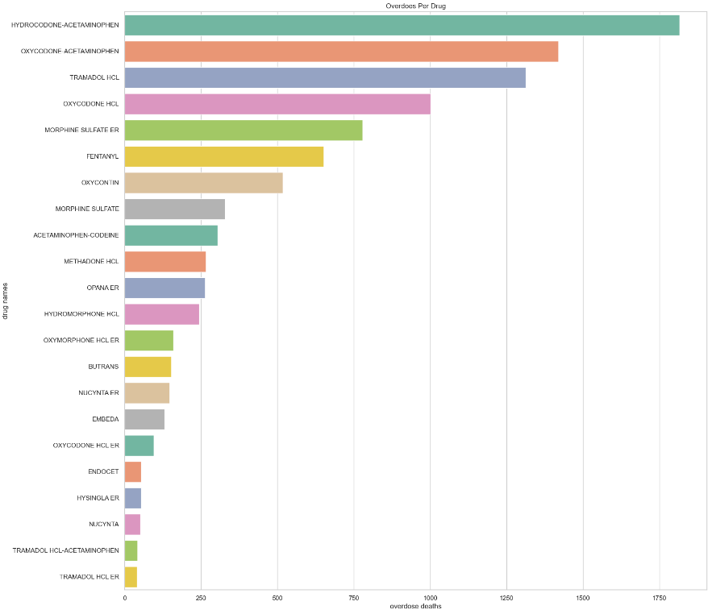

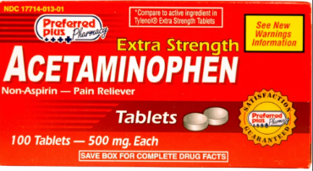
Deadliest Opioids
Notes:
douglas

Slide 7
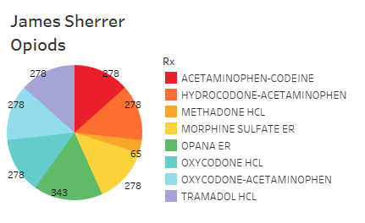
Deadliest Opioids
Hydrocodone-Acetaminophen & Oxycodone-Acetaminophen are the two deadliest prescription opioids. This is possibly due to toxicity of the liver caused by an overdose of acetaminophen as opposed to the opioid itself.
Hydrocodone-Acetaminophen + Oxycodone-Acetaminophen make up slightly less than ⅓ of overdoses from all opioids combined.
Extremely common to see patients prescribed more than one opioid. At times, some patients appear to even have multiple prescriptions for the same medicine.
Very common to see patients die from multiple opioids (example: James Sherrer died of overdose with 7 different opioids prescribed to him)[numbers on pie chart represent pill count per 90 days].
Notes:
Douglas - Hydrocone-Acetaminophen & Oxycodone-Acetaminophen also 2 most prescribed drugs

Slide 8
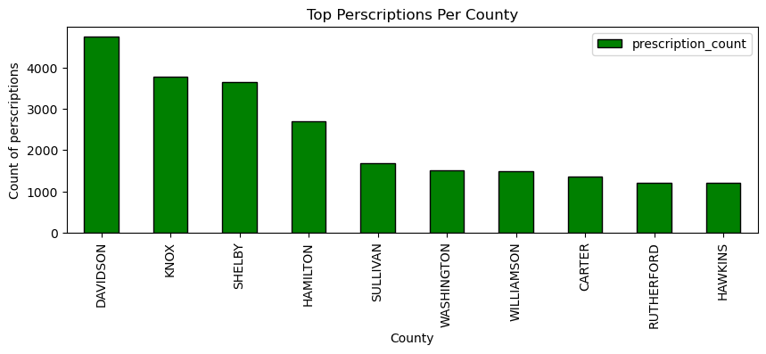
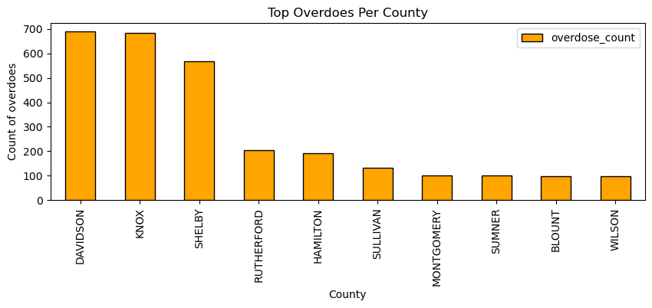
Top 10 overdose prescriptions vs deaths by county
Davidson | Knox | Shelby | Hamilton
Notes:
george

Slide 9
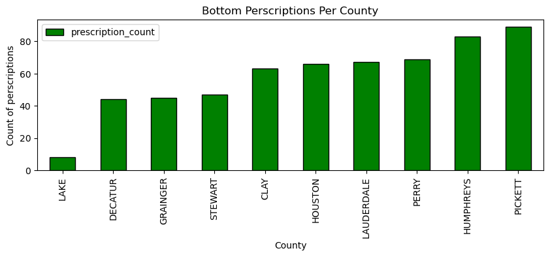
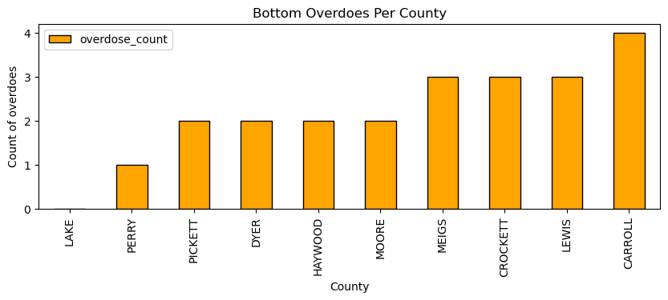
Bottom 10 overdose prescriptions vs deaths by county
Lake County
Notes:
george

Slide 10
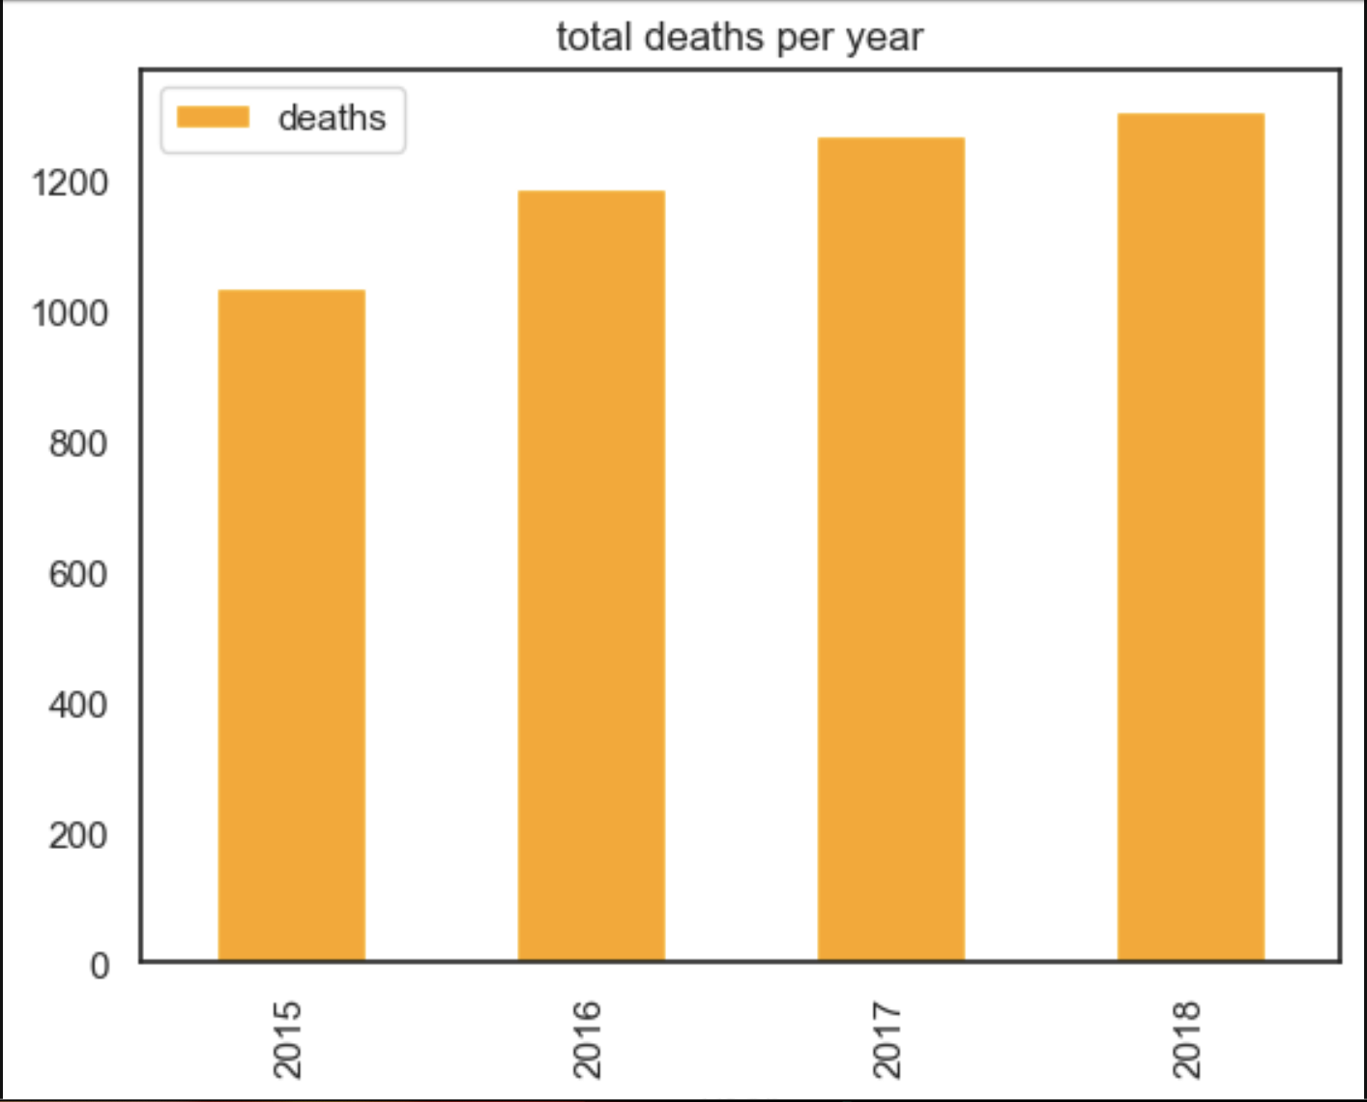
Overdose Death Trend in Tennessee by Year 2015-2018
Overall deaths are trending upward
2015 = 1033
2016 = 1186
2017 = 1267
2018 = 1304
Notes:
patrick

Slide 11
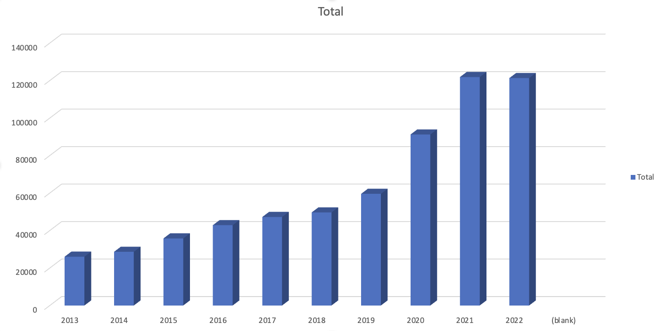
Overdose Death Trend in Tennessee by Year 2013-2022
2013
26049
2014
28633
2015
35794
2016
42853
2017
47223
2018
49663
2019
59565
2020
91226
2021
121862
2022
121317
Notes:
patrick

Slide 12
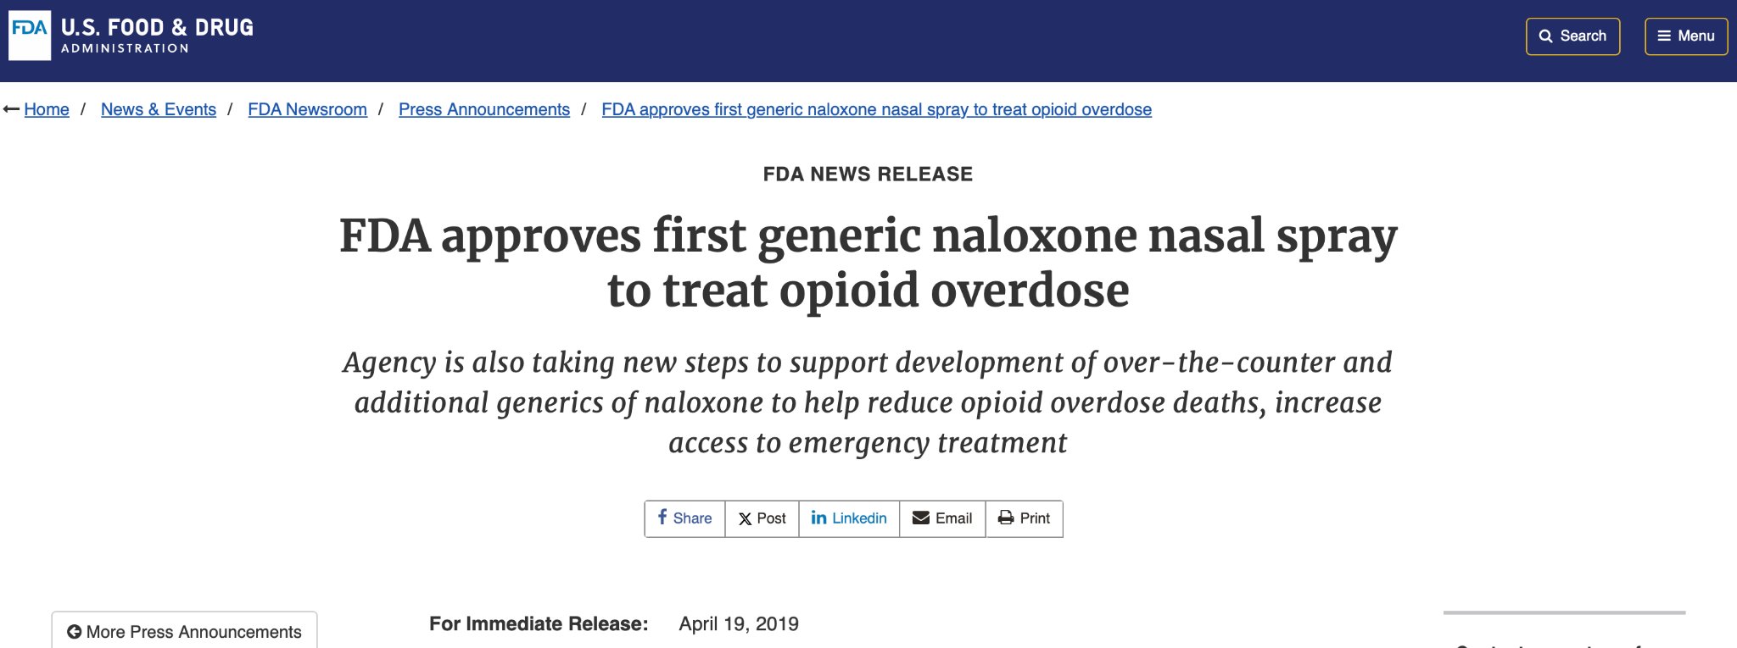
Possible Effects of Naloxone Starting in 2019
Notes:
patrick

Slide 13
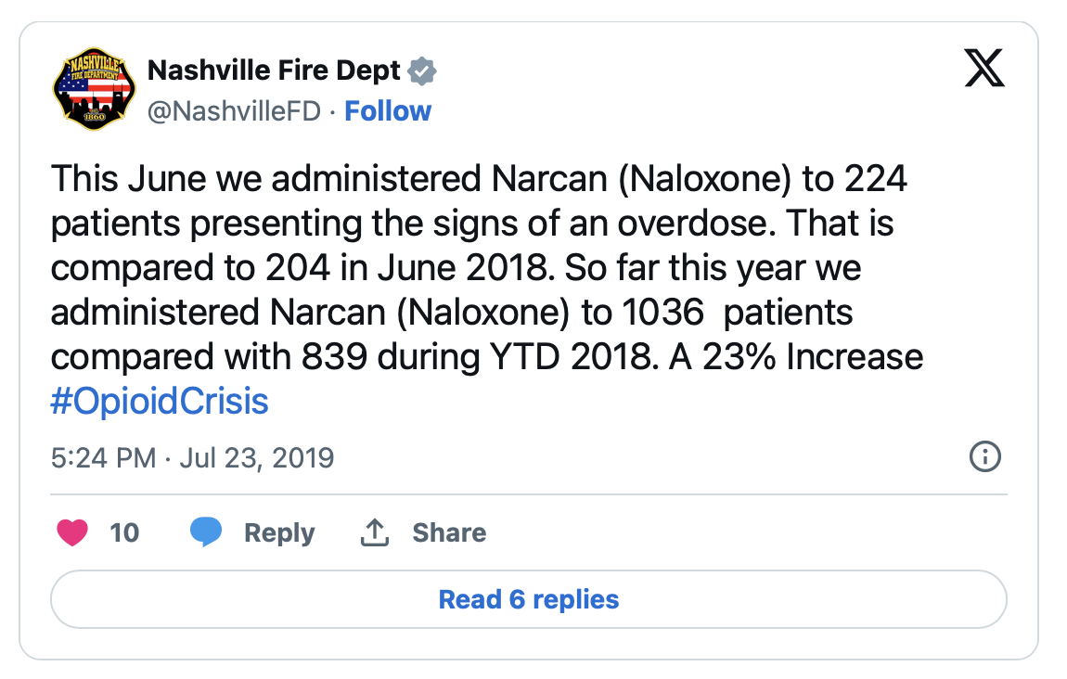
Narcan Intervention from June 2018 - July 2019
From October 2017 through June 2024, the ROPS distributed more than 678,000 units of naloxone, and TDMHSAS has documented at least 82,000 lives saved because of naloxone distributed during that time. Because of stigma and other factors, the department believes the actual number of lives saved is much higher.
source: tn.gov
Notes:
patrick

Slide 14
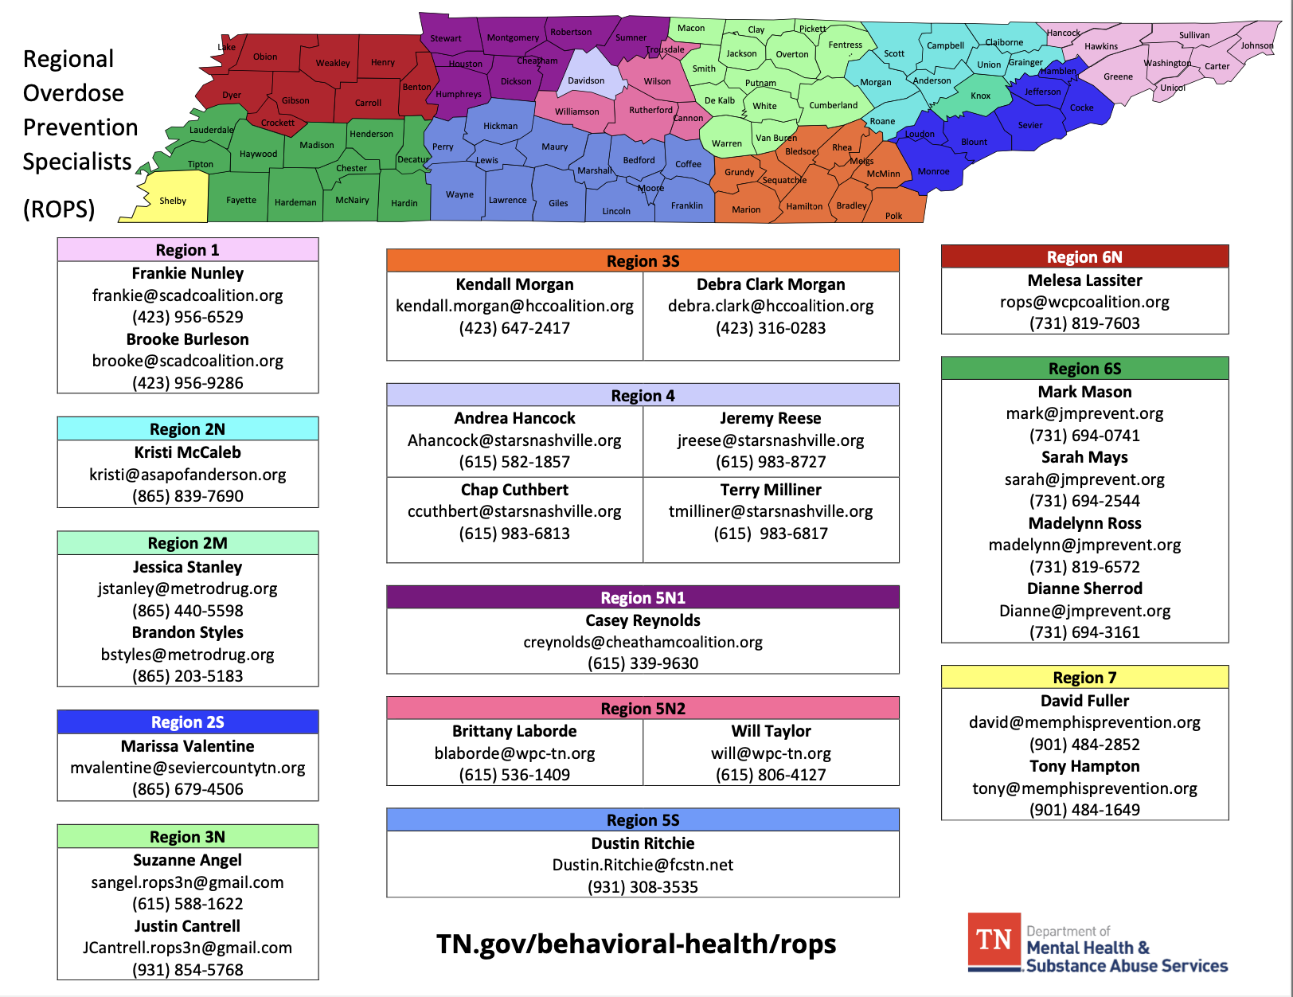
Where to get help:
Notes:
George

